Slide 1
Infosys
Springboard
Infosys _Smart Urban Mobility and Traffic Intelligence Dashboard Group 1_Batch-1
Presentation
TEAM MEMBERS
Infosys Springboard
Data Analytics Project
2026
Piyush (Team Lead)
Pooja
Parul
Premika
Ramita
Mentor: Jayasri V

Slide 2
Problem Statement
Infosys
Springboard
Why does Bengaluru's mobility data need a unified analytical platform?
Fragmented Mobility Data
Data Inconsistency
Limited Spatial Understanding
No Unified Mobility View
Bengaluru mobility information is spread across multiple datasets covering public transit, traffic, weather, road safety, demographics, and ride-hailing. Each dataset represents a different aspect of the city's transportation system.
The datasets use different schemas, formats, identifiers, data types, and levels of detail. Without proper cleaning and standardization, combining these sources for analysis becomes difficult and unreliable.
Individual datasets can show specific patterns, but they do not easily reveal relationships between traffic conditions, transit performance, weather, accidents, population characteristics, and travel demand.
Without an integrated analytical system, it is difficult to obtain a single view of Bengaluru's mobility performance or compare different mobility indicators together for meaningful decision-making.
GOAL:
Build a unified Smart City Mobility Intelligence system that integrates mobility, traffic, accident, route, stop, fare and geospatial information to provide interactive, location-based insights into Bengaluru's transportation patterns and support data-driven mobility analysis..
Fragmented Data → Data Integration → Multi-Domain Analytics → Actionable Mobility Insights
· Infosys Springboard · Trial Presentation – 2026
3/16

Slide 3
Project Objectives
Infosys
Springboard
End-to-end scope of the Urban Pulse Smart City Mobility Intelligence project
1
2
3
4
5
Data Integration
Multi-Type Coverage
Power BI Dashboard
Trend & Performance
Interactive
Combine Multiple Mobility Datasets
Integrate mobility, traffic, transit, route, stop, accident, fare and location-based datasets into a structured analytical model for unified mobility analysis.
Integrate multiple mobility datasets to provide a combined view of trips, routes, stops, traffic conditions, accidents and geographic mobility patterns.
Build interactive Power BI dashboards for Geospatial Analytics, Traffic & Road Safety, and Reliability Metrics with filters and KPI cards.
Analyse trip demand, stop arrivals, route activity, traffic speed, congestion, incidents, fares and reliability patterns across time and locations.
Support interactive exploration of mobility conditions through date, area, ward and station filters, enabling users to examine changing mobility patterns and performance indicators.
Project Deliverables
Master Dataset CSV
Power BI Dashboard
Final PPT Report
Prepared and structured mobility datasets used as the foundation for the Power BI analysis.
Interactive dashboards covering Geospatial Analytics, Traffic & Road Safety, and Reliability Metrics.
Professional presentation documenting the project, datasets, methodology, completed modules, dashboards and key insights.
4/16

Slide 4
Modules Overview - 5 Milestones
Infosys
Springboard
Each milestone maps to an interactive Power BI dashboard page
M1
M2
M3
M4
M5
Data Integration & Modeling
Geospatial & Transit Analytics
Traffic & Road Safety Analytics
Reliability Metrics & Mobility Performance
Final Integration & Dashboard Delivery
Dataset collection, cleaning and processing, field standardization, table merging, relationship creation and Power BI data modeling.
Geospatial stop distribution, top routes and stops, trip demand trends, stop-arrival analysis and location-based mobility visualization.
Traffic speed and volume analysis, congestion levels, road-capacity utilization, transit-stop usage and traffic incident analysis
Traffic reliability, ride reliability, weather reliability and safety metrics with accident distribution, zone analysis and traffic conditions over time.
Integrated Power BI modules with interactive filters, KPI cards, analytical measures and consolidated mobility insights for presentation and reporting.
▶
▶
▶
▶
✅ Completed
✅ Completed
✅ Completed
✅ Completed
✅ Completed
5/16

Slide 5
Milestone 1 - Data Integration & Modeling
Infosys
Springboard
Collecting, cleaning, integrating, and modeling multi-source urban mobility data for Power BI analytics
✅ Completed — What Was Done
Multiple mobility datasets collected covering traffic conditions, trips/routes, stops/stations, accidents, fares and geographic information for Bengaluru.
DATA SOURCES
Multi-source mobility data
Traffic & mobility records
Trip and route information
Stop/station locations
Accident and safety records
Fare and travel information
Geographic/location attributes
Data cleaning and preprocessing completed to improve consistency across datasets
Datasets merged and connected in Power BI to create a unified analytical model
Relationships created between related tables, including one-to-many relationships,
Geospatial fields prepared with latitude/longitude and location attributes to support Bengaluru stop distribution, geographic analysis and route-level visualization.
⏭ Next Steps
Finalize the integrated Power BI data model and validate relationships across mobility, traffic and geospatial tables.
Build Geospatial Mobility Analytics using stop locations, route information and trip movement patterns.
Develop Origin–Destination analysis to understand major trip flows and frequently used corridors.
Identify high-demand locations and potential congestion hotspots using available trip, arrival and traffic-related information.
Complete Transit Reliability and Traffic Reliability dashboards using calculated reliability and safety metrics.
Add interactive filtering and drill-down analysis by date, station/stop, ward and route wherever the available data supports it.
Power BI measures created for key indicators such as Total Trips, Total Stops, Total Routes, Total Accidents and Average Fare, enabling dynamic dashboard calculations.
Date filtering and interactive relationships implemented so visuals respond to selected time periods and other dashboard filters.
6/16

Slide 6
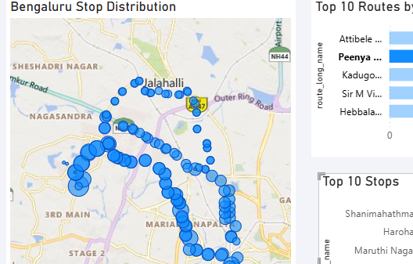
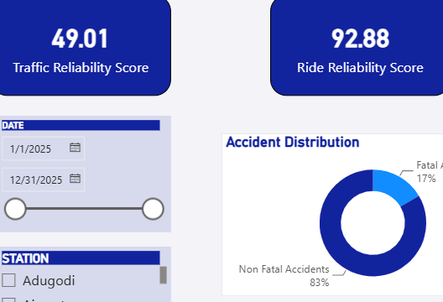
Milestone 2 - Geospatial & Transit Analytics
Infosys
Springboard
Geographic mobility patterns • Route and stop analysis • Transit reliability & traffic conditions
✅ Delivered
Geospatial Mobility & Transit Analytics
Geospatial Mobility & Transit Analytics
Bengaluru geospatial mobility dashboard developed using stop, route and trip-level location data.
Geographic distribution of mobility stops visualized using latitude and longitude to understand the spatial spread of the network.
Top routes and high-activity stops identified using trip counts and stop-level activity.
Origin–Destination mobility analysis developed to examine movement between starting and ending locations/routes.
Temporal trip analysis implemented using monthly demand and hourly stop-arrival patterns
.
Transit reliability metrics dashboard created covering traffic reliability, ride reliability, weather reliability and safety performance.
Geospatial Coverage: Mapped Bengaluru mobility stops using location coordinates to visualize the spatial distribution of the transport network.
Route & Stop Activity: Compared routes and stops using trip activity to identify frequently used mobility corridors and high-activity locations.
Indian Natinal Congress
Bharatiya Janata Party
Independent
Telugu Desam
INC (I)
Janata Party
782
CPI(M)
533
Temporal Mobility: Analysed trip demand and stop arrivals across different time periods to understand mobility patterns and peak activity.
Reliability & Safety: Combined traffic, ride, weather and safety indicators with accident distribution to provide an overall view of mobility reliability.
DEMO SCREENSHOT
Dashboard Outcome: A unified geographic and transit view of Bengaluru that connects where mobility occurs, how people move, when demand changes, and how reliable the network is.
7/16

Slide 7
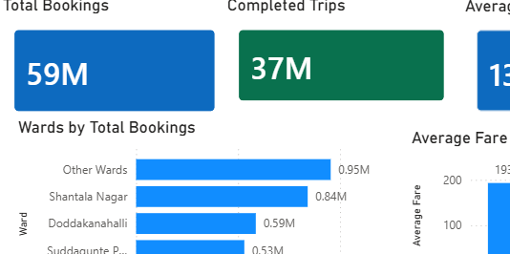
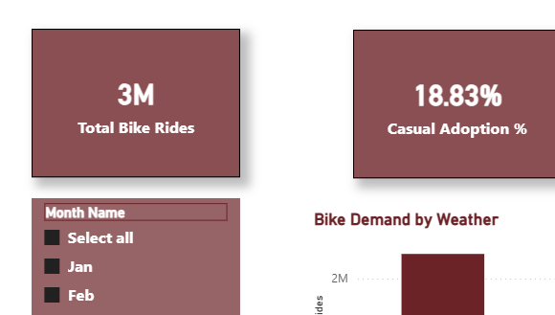
Milestone 3 - Ride-Hailing & Demand Intelligence
Infosys
Springboard
Trip demand patterns • Fare analysis • Temporal mobility behaviour • Demand intelligence
Ride/trip demand analysis developed using trip-level mobility records.
Monthly demand patterns analysed to understand changes in trip activity across the year.
Hourly arrival analysis implemented to identify periods of higher and lower mobility activity.
Route-level demand comparison performed using trip counts to identify frequently used routes.
Stop-level demand analysis used to identify high-activity mobility locations.
Fare analysis incorporated to examine average fare alongside trip and route information.
LIVE RESULT TRACKER · Party Seat Tally
543
272
INC
BJP
Total Seats
Majority Mark
Simulated Lead
Simulated 2nd
Indian National Congress
310
Bharatiya Janata Party
200
Regional / Others
33
CONSTITUENCY RESULT DETAILS
Demand Concentration
Booking activity is concentrated across a limited number of high-demand wards and routes.
Temporal Patterns
Monthly and hourly analysis helps identify periods of higher and lower trip activity.
Route & Stop Activity
Frequently used routes and high-activity stops provide a clear view of mobility demand.
Fare & Demand Relationship
Average fare can be compared with trip volume to understand fare patterns across routes and locations.
Dashboard Value
Interactive filters allow demand patterns to be explored by time, route and location.
State
Constituency
Leading Candidate
Party
Margin
Andhra Pradesh
Ongole
Maganti M
TDP
12,450
Bihar
Patna Sahib
R S Prasad
BJP
95,210
Delhi
New Delhi
Meenakshi L
BJP
78,300
Gujarat
Gandhinagar
Amit Shah
BJP
557,014
MP
Indore
K Vijayvargiya
BJP
1,043,000
DEMO SCREENSHOT
This module converts trip-level mobility records into demand intelligence by combining route activity, stop activity, temporal patterns and fare information to understand where, when and how mobility demand is concentrated.
8/16

Slide 8
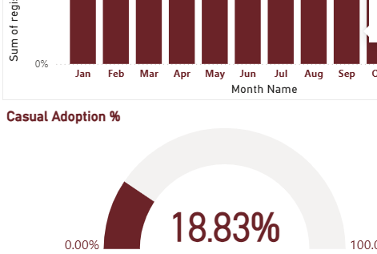
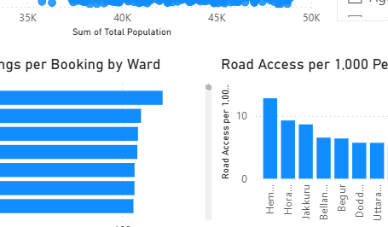
Milestone 4 - Equity, Forecasting & Finalization
Infosys
Springboard
Mobility accessibility • Demand forecasting • Final dashboard integration & insights
Mobility accessibility analysis
Compared mobility availability across different geographic areas and wards using location-based mobility data.
Identified areas with higher and lower access to transport services.
Demand & usage trend analysis
Analysed trip volume and mobility demand patterns across available dates and time periods.
Used temporal trends to understand periods of higher and lower mobility activity.
Integrated dashboard analysis
Combined geospatial, traffic, transit and reliability views into a unified analytical workflow.
Added interactive filters for date, station/stop and geographic areas.
Decision-support insights
Highlighted high-activity routes/stops, reliability patterns, accident distribution and mobility gaps.
Converted raw mobility data into visual insights that can support transport planning and operational decisions.
VOTER TURNOUT & DEMOGRAPHICS
✅ Delivered
Gender winners: Male 94.4% · Female 5.6%
GENDER DISTRIBUTION
CONSTITUENCY CATEGORY
30.03%
General
20,302
Male 94.4%
25,885
ST
4,228
Female 5.6%
1,530
Average Voter Turnout
2,771
Highest: Tripura 59.6%
AVG TURNOUT % BY STATE
Final Outcome
Multiple mobility datasets were integrated into a unified Power BI analytical workflow.
Interactive dashboards convert the raw Bengaluru mobility data into visual insights for analysis and decision-making.
Tripura
Delhi
Goa
MP
Maha.
Bihar
Megh.
Arunachal
AP
J&K
DEMO SCREENSHOT
Integrated mobility analysis brings traffic, transit, reliability and accessibility indicators together for Bengaluru.”
9/16

Slide 9
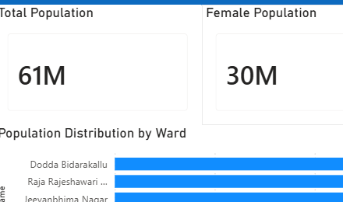
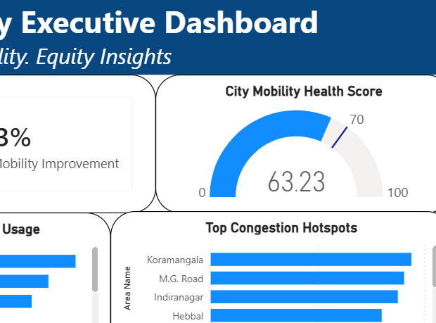
Mobility Equity & Executive Intelligence
Infosys
Springboard
Mobility access • Performance monitoring • Forecasting & anomaly insights • Executive reporting
✅ Delivered in Demo
PARTY & CANDIDATE PERFORMANCE · Top Wins
City-wide mobility performance analysis developed by combining traffic, transit and geospatial indicators.
Mobility Access analysis used to compare transportation availability and accessibility across geographic areas.
High-demand and underserved areas identified through spatial distribution of mobility activity
.
Traffic and transit performance indicators consolidated to provide an overall view of mobility conditions.
Trend analysis implemented to compare mobility patterns across available time periods.
Anomaly identification used to highlight unusual traffic, accident or mobility activity.
Executive-level KPIs and visual summaries designed to convert detailed dashboard analysis into actionable insights.
State-wise party dominance mapping and heatmap
TOP 10 PARTIES BY ALL-TIME WINS
Top 10 winning candidates by vote count
Indian National Congress
10,015
Bharatiya Janata Party
4,990
Win/loss margin analysis per constituency
Independent
1,484
Telugu Desam Party
1,450
Candidate re-election performance tracker
INC (I)
1,004
Alliance-level seat tally insights
Janata Party
782
RJD
568
CPI(M)
533
Janata Dal
529
INC
BJP
Shiv Sena
471
10,015 wins
4,990 wins
TOP CANDIDATES BY VOTES RECEIVED
Combining geographic distribution, mobility activity, reliability and safety indicators provides a city-wide view of where mobility performance is strong, where congestion or disruptions occur, and which areas require attention.
TDP
INC(I)
Kailash Vijayvargiya
BJP
1,734,313
1,450 wins
1,004 wins
Yogender
BJP
1,480,000
Sushma Swaraj
BJP
1,120,000
Rajnath Singh
BJP
932,000
DEMO SCREENSHOT
The final analytics layer converts individual mobility datasets into a unified decision-support view for identifying accessibility gaps, monitoring performance, detecting unusual patterns and supporting data-driven urban mobility planning.
10/16

Slide 10
Challenges & Solutions
Infosys
Springboard
Issues encountered and how the team resolved them
CHALLENGE
SOLUTION
Multiple Data Sources
Mobility analysis required combining different datasets covering traffic, transit/mobility activity, location and geospatial information.
Collected and consolidated the required datasets into a common Power BI workflow, then standardized the fields needed for combined analysis.
Inconsistent Data Formats
Source datasets had differences in column names, data types, date formats and field structure, making direct analysis difficult.
Used Power Query in Power BI to clean, transform and standardize the datasets before loading them into the data model.
Linking Different Datasets
The datasets represented different aspects of mobility, so they could not be analyzed together without establishing appropriate relationships.
Created relationships between the relevant tables/fields in Power BI Data Model, allowing filters and visuals to work across the integrated datasets.
14/16

Slide 11
Final Execution Plan
Infosys
Springboard
Roadmap before final evaluation — 5 steps to completion
Bengaluru Dataset Preparation
Transit & Reliability Analysis
Power BI Dashboard & Integration
Bengaluru mobility datasets collected and consolidated
Data cleaned and standardized for analysis
Required fields prepared for Power BI dashboards
Transit reliability metrics analyzed
Ride reliability and traffic conditions visualized
Accident distribution and station-level analysis included
Interactive Bengaluru mobility dashboards developed
Relationships between dimension and fact tables created
Filters and interactive visuals added for analysis
Final dashboards integrated for presentation
1
2
3
4
5
Geospatial Analysis
Mobility & Ride-Hailing Analysis
Bengaluru stop locations visualized using latitude and longitude
Top routes and high-activity stops identified
Origin–Destination mobility patterns analyzed
Ride-hailing mobility patterns analyzed
Trip-level and temporal patterns visualized
Mobility insights presented through interactive dashboard visuals
16/16

Slide 12
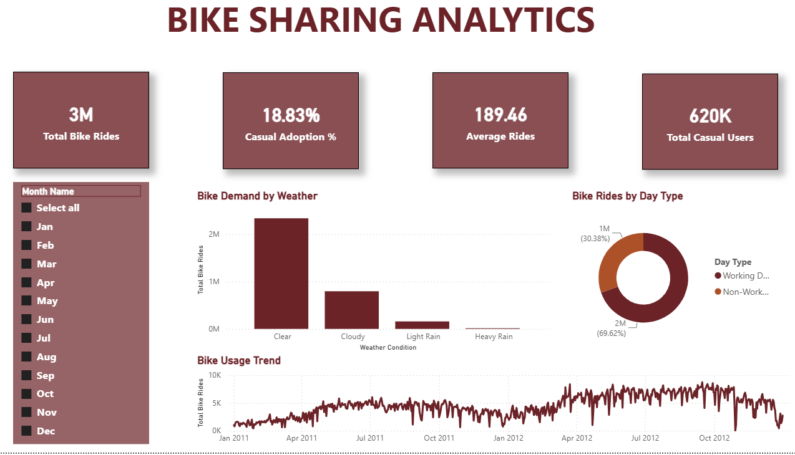
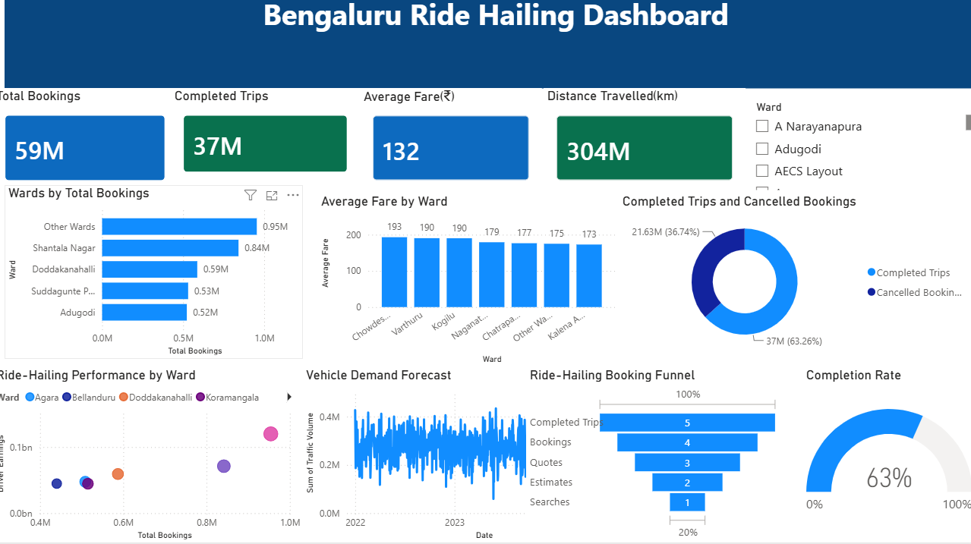
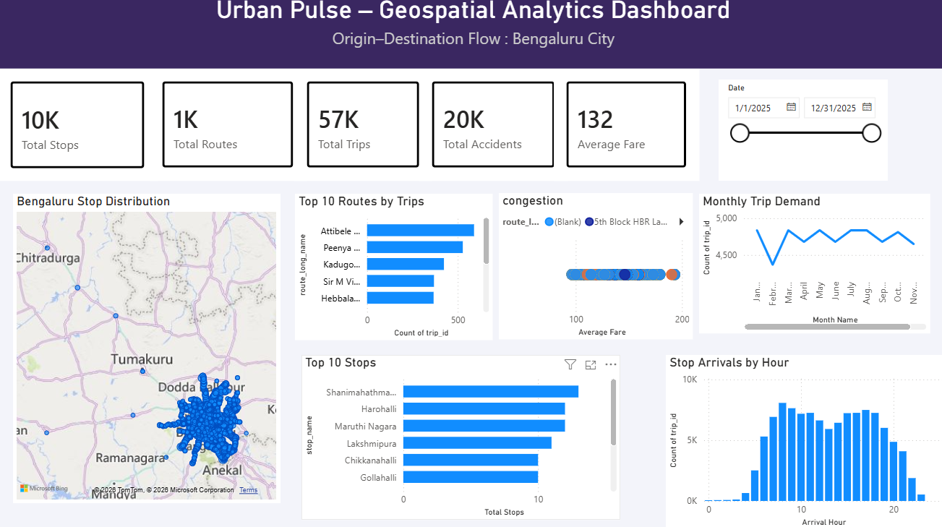
Dashboards
Infosys
Springboard
Other dashboards are uploaded on Github repository

Slide 13
Team Responsibilities
Infosys
Springboard
Individual contributions and role assignments
P
P
P
P
R
Piyush
Parul
Pooja
Premika
Ramita
Data Engineer (Team Lead)
Transit & Ride-Hailing Analyst
Geospatial Analyst
BI Lead / Project Manager
Micromobility & Equity Analyst
Collected and consolidated the project datasets.
Merged assigned datasets and validated the data.
Managed GitHub repository and project files.
Worked on Power BI data preparation and dashboard development.
Developed the geospatial dashboard
Transit and ride-hailing analysis
Trip and route-level demand analysis
Monthly and hourly mobility pattern analysis
Stop and route activity analysis
Fare and trip-related insights
Supported development of mobility dashboards
Conducted origin-destination (OD) flow analysis to understand mobility patterns. ​
​
Created accessibility and isochrone maps to measure travel reachability.​
​
Developed heatmaps to visualize mobility and demand patterns. ​
​
Identified and visualized congestion hotspots across different geographic areas. ​
​
Performed geographic drill-down analysis and integrated weather overlays to understand their impact on mobility.​
Power BI dashboard development and integration
Data model and table relationship review
Dashboard layout and visualization design
Interactive filters and dashboard usability
Integration of geospatial, transit, traffic and demand views
Final presentation and project coordination
Analysed bike-share utilization and station usage patterns. ​
​
Monitored station availability and identified supply-demand gaps. ​
​
Predicted bike rebalancing needs across stations. ​
​
Calculated Mobility Access Index(MAI) to measure accessibility. ​
​
Compared mobility access across demographic groups and identified underserved neighborhoods. ​
13/16

Slide 14
Infosys
Springboard
Thank
PRESENTED BY
Piyush
You!
Pooja
Parul
Infosys Springboard
Premika
🎤 We'd love to answer your questions!
Ramita
Infosys Springboard · Data Analytics Project · 2026
🗂️ GitHub Repository : https://github.com/Piyushydv19/Urban-Pulse-Smart-City-Mobility-Intelligence

